Slide 1

React + Redux

Slide 2



Let’s get started
Source: https://www.flickr.com/photos/mike52ad/

Slide 3

ECMAScript2015
const sum = (first, second) => { return first + second;
}

Slide 4
Main goals of ES6
fix (some of) ES5 problems
backwards compatibility (ES5 code is valid in ES6)
modern syntax
better suited for big applications new features in standard library
•
•
•
•
•

Slide 5
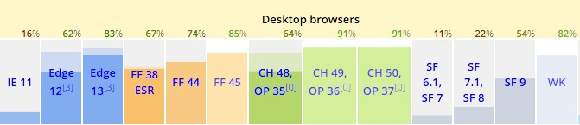
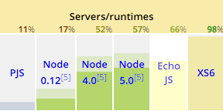
ES6 -today
kangax.github.io/compat-table

Slide 6



Created by Sebastian McKenzie
ECMAScript 2015 Support, JSX Support
Widely adopted

Slide 7

ES6 in browsers today
•
ES6 => ES5 transpilers

Slide 8
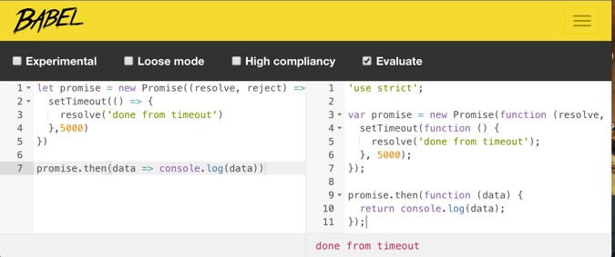
Babel - usage
command line:
$ babel es6.js -o es5.js
Online:
•
Konfigurator: http://babeljs.io/docs/setup/

Slide 9
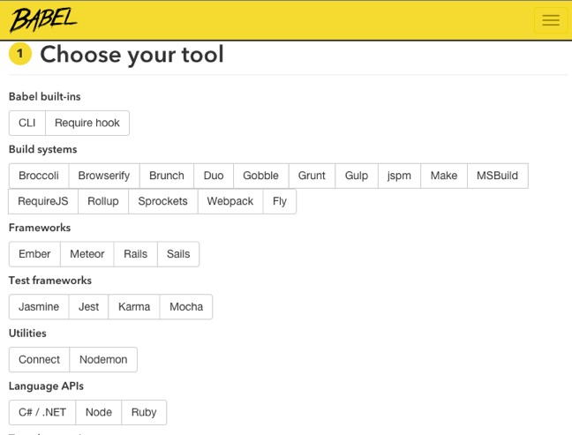
Babel - użycie
•
Online wizard: http://babeljs.io/docs/setup/

Slide 10

ES6 in practice

Slide 11
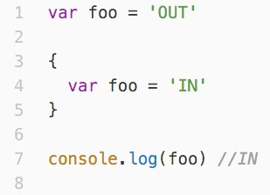
ES5: var

Slide 12
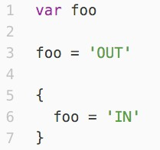
ES5: var - hoisting

Slide 13
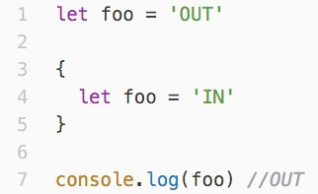
ES6: let is new var

Slide 14
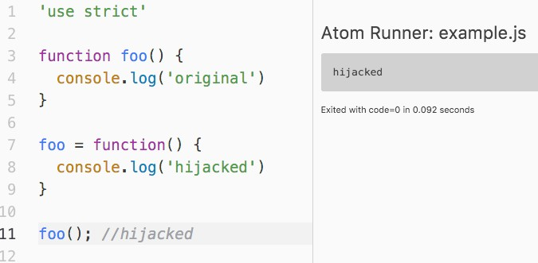
ES5…

Slide 15
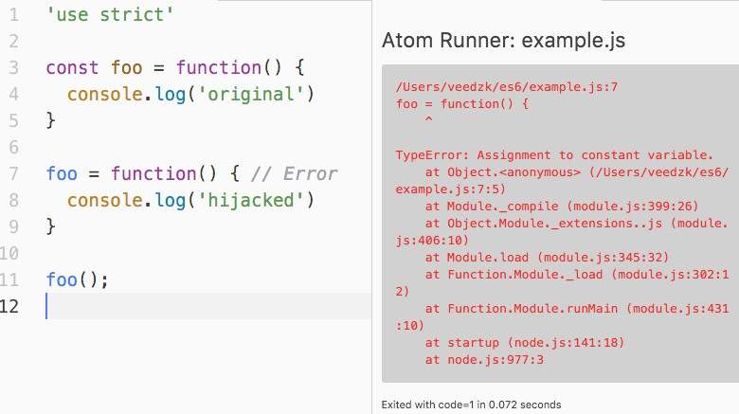
…ES6: const

Slide 16
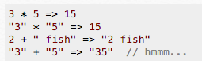
ES5: concatenation

Slide 17
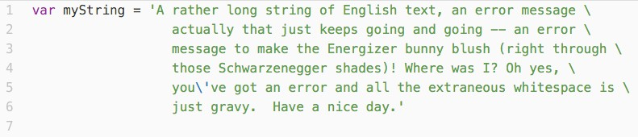
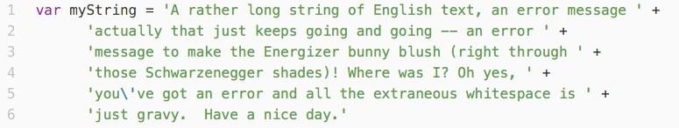
ES5: long strings

Slide 18
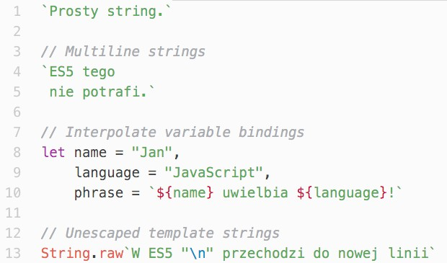
ES6: Template strings

Slide 19


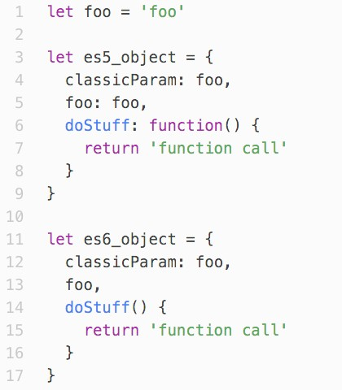





ES6: Object declarations

Slide 20
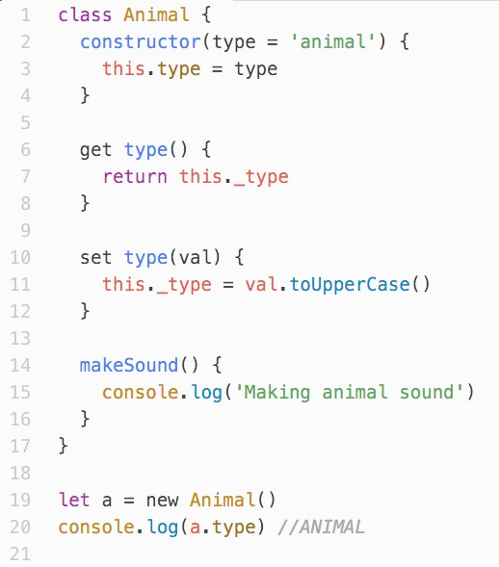
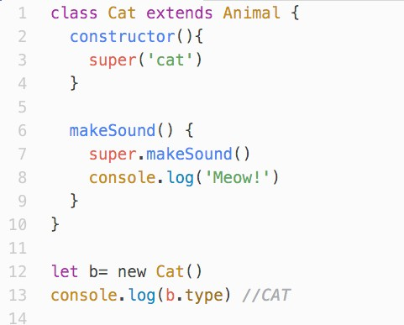
ES6: Classes

Slide 21
ES6: Classes

Slide 22








ES6: Setters & getters

Slide 23
ES6: Default params

Slide 24
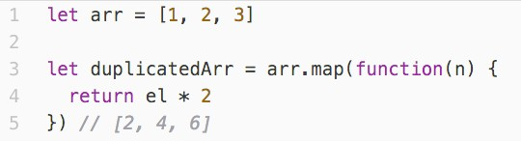
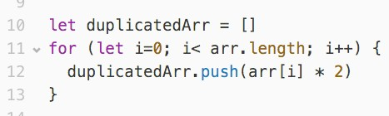
ES5 recap: map
el

Slide 25
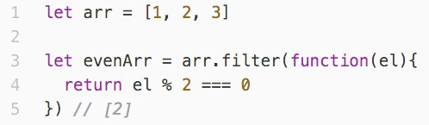
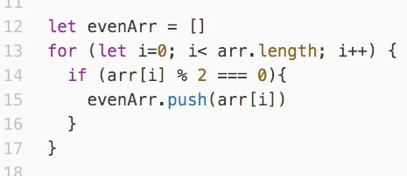
ES5 recap: filter

Slide 26
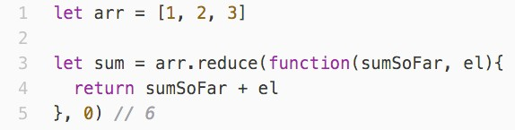
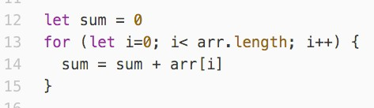
ES5 recap: reduce

Slide 27
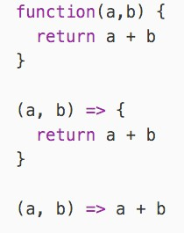
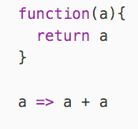
ES6: Arrow functions

Slide 28
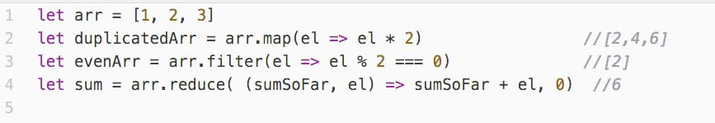
ES6: Arrow functions

Slide 29
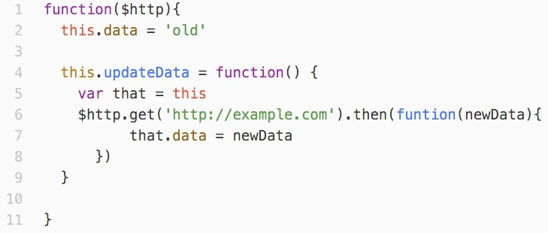
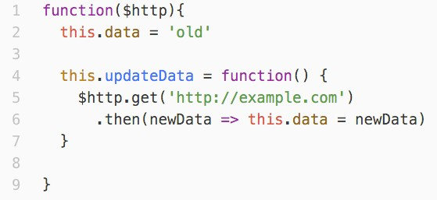
Arrow functions: this

Slide 30
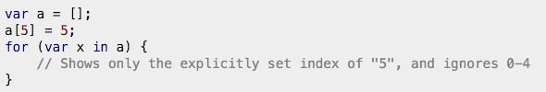
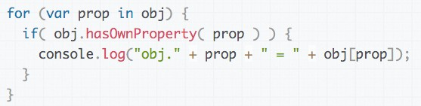
ES5: for … in
•
best practice: avoid that loop

Slide 31
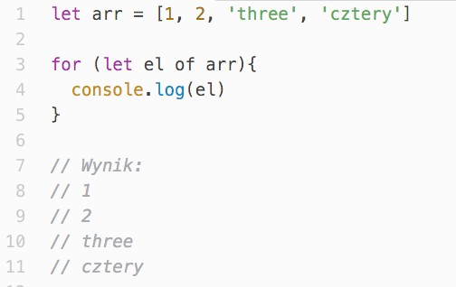
ES6: for … of
•
for … of can iterate not only over arrays
•
Homework: Iterators in ES6

Slide 32
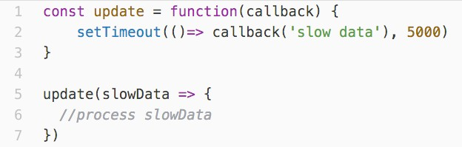
Asynchronus programming
•
common in JS (animations, server requests, etc.) Classic solution: callback
Problem: only one callback per async task
•
•

Slide 33
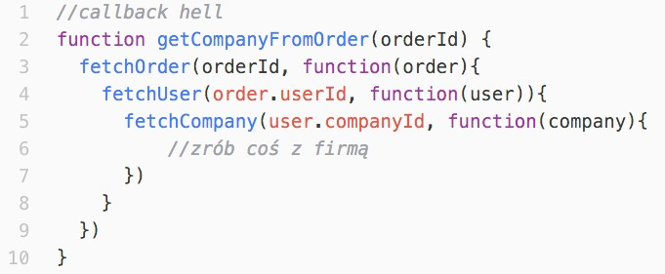
Async programming, ES5
•
Problem: Nested functions create messy code

Slide 34
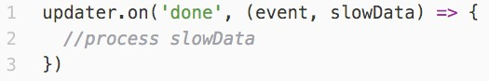
Async programming, ES5
•
Second try: Listeners
Problem: no reaction when async function ends before listener registers, often hard to debug
•

Slide 35
ES6: Promise
•
object that keeps a result of an async function (waiting, resolved, rejected)
•
fixes earlier problem with listeners, since callback is called even if async function completed the task earlier
•
allows to return (Promise) objects and work with them, even if async function is still not completed (better code readability)
•
“promises” that it will get resolved
•
uses Observer pattern to populate the result
•
flattens nested promises to avoid “callback hell”

Slide 36














Promises
Promise
Listener 1
States: waiting
resolved rejected
•
•
•
Listener 2
Listener 3
async function

Slide 37
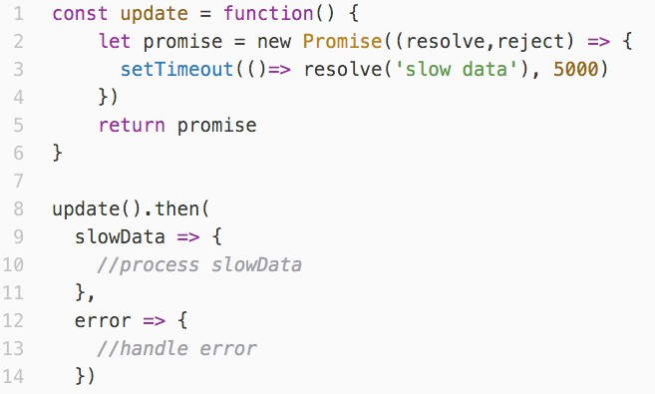
Promises

Slide 38
Callback hell, ES5

Slide 39
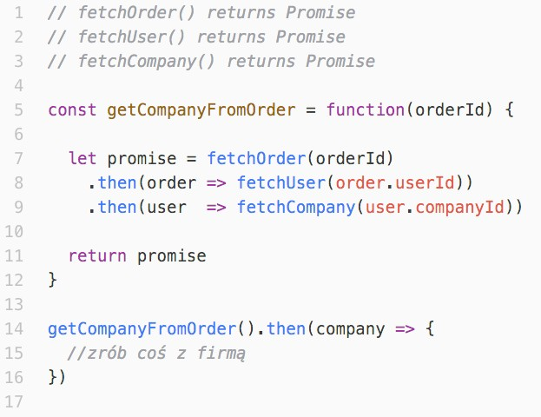
Promises

Slide 40
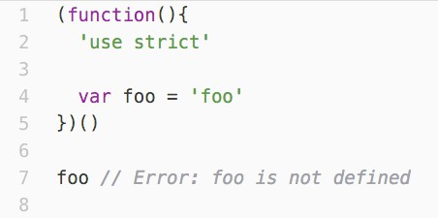
Modules (ES5)
•
IIFE (Immediately Invoked Function Expression)
•
controls variable exposure

Slide 41
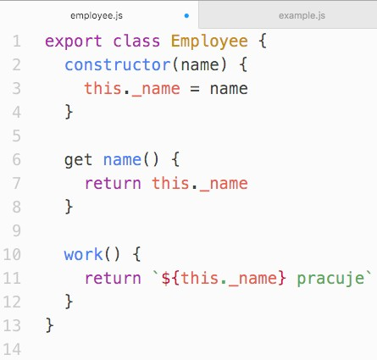
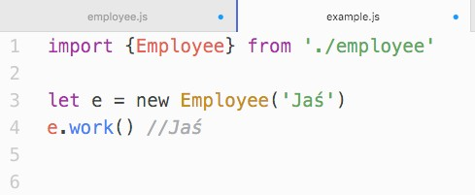
Modules (ES6) in browser
•
use tools such as Browserify / Webpack,
•
native ES6 modules are not yet implemented

Slide 42
What we have learned?
•
let/const
•
template strings
•
new ways to declare objects
•
classes
•
map, filter, reduce (ES5)
•
arrow functions
•
for … of
•
Promises
•
Modules

Slide 43
Other ES6 features
•
Proxy
•
Iterators
•
Generators
•
Symbols
•
Map/Set, WeakMap/WeakSet
•
extended standard library (Number, Math, Array)

Slide 44
React
React is a JavaScript Library for building user interfaces.
Focus on the UI, not a Framework
One-way reactive data flow (no two-way data binding)
Virtual DOM

Slide 45
Virtual DOM
Keep track of state in DOM is hard.
The DOM API is slow.
(Try to re-render the whole DOM on every change)

Slide 46
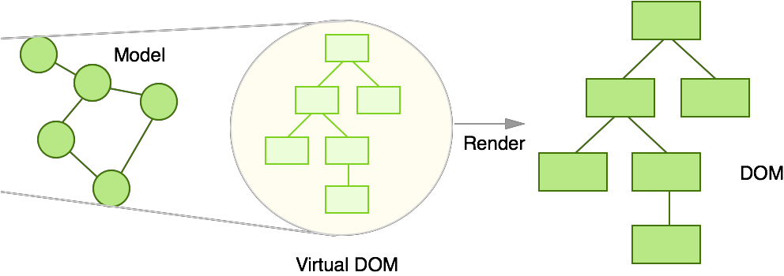
Virtual DOM
Source: http://teropa.info/blog/2015/03/02/change-and-its-detection-in-javascript-frameworks.html

Slide 47
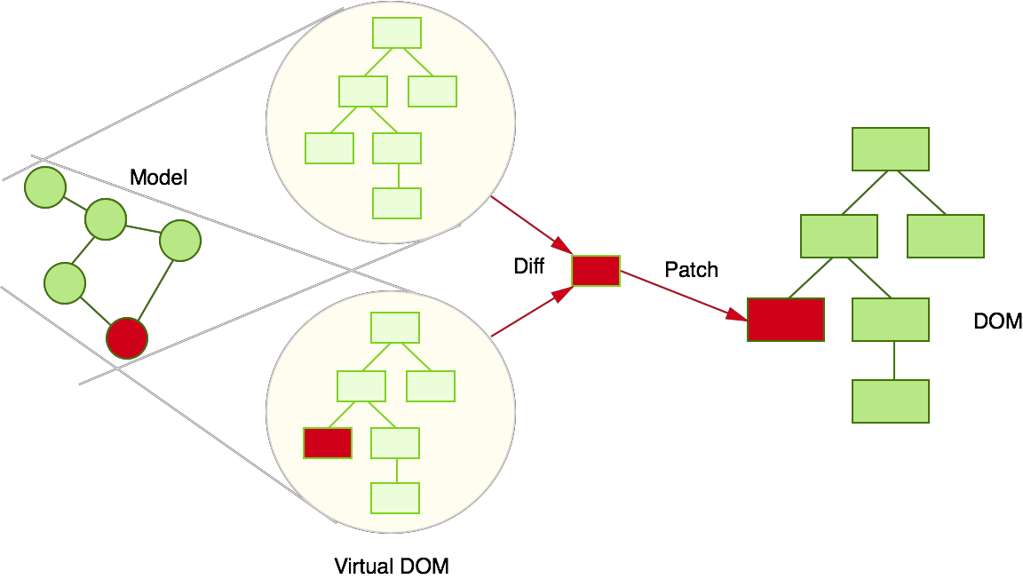
Virtual DOM
Source: http://teropa.info/blog/2015/03/02/change-and-its-detection-in-javascript-frameworks.html

Slide 48
Virtual DOM Benefits
Batched DOM read/write operations.
Efficient update of sub-tree only.

Slide 49
Our first Experiment Part I
<!DOCTYPE html>
<html>
<head>
<meta charset="UTF-8" />
<script src="bundle.js"></script>
</head>
<body>
<div id="example"></div>
</body>
</html>
index.html

Slide 50
Our first Experiment Part II
import React from 'react'; import ReactDOM from 'react-dom';
const exampleElement = document.getElementById('example');
ReactDOM.render(<h1>Hello, world!</h1>, exampleElement);
main.js -> bundle.js

Slide 51
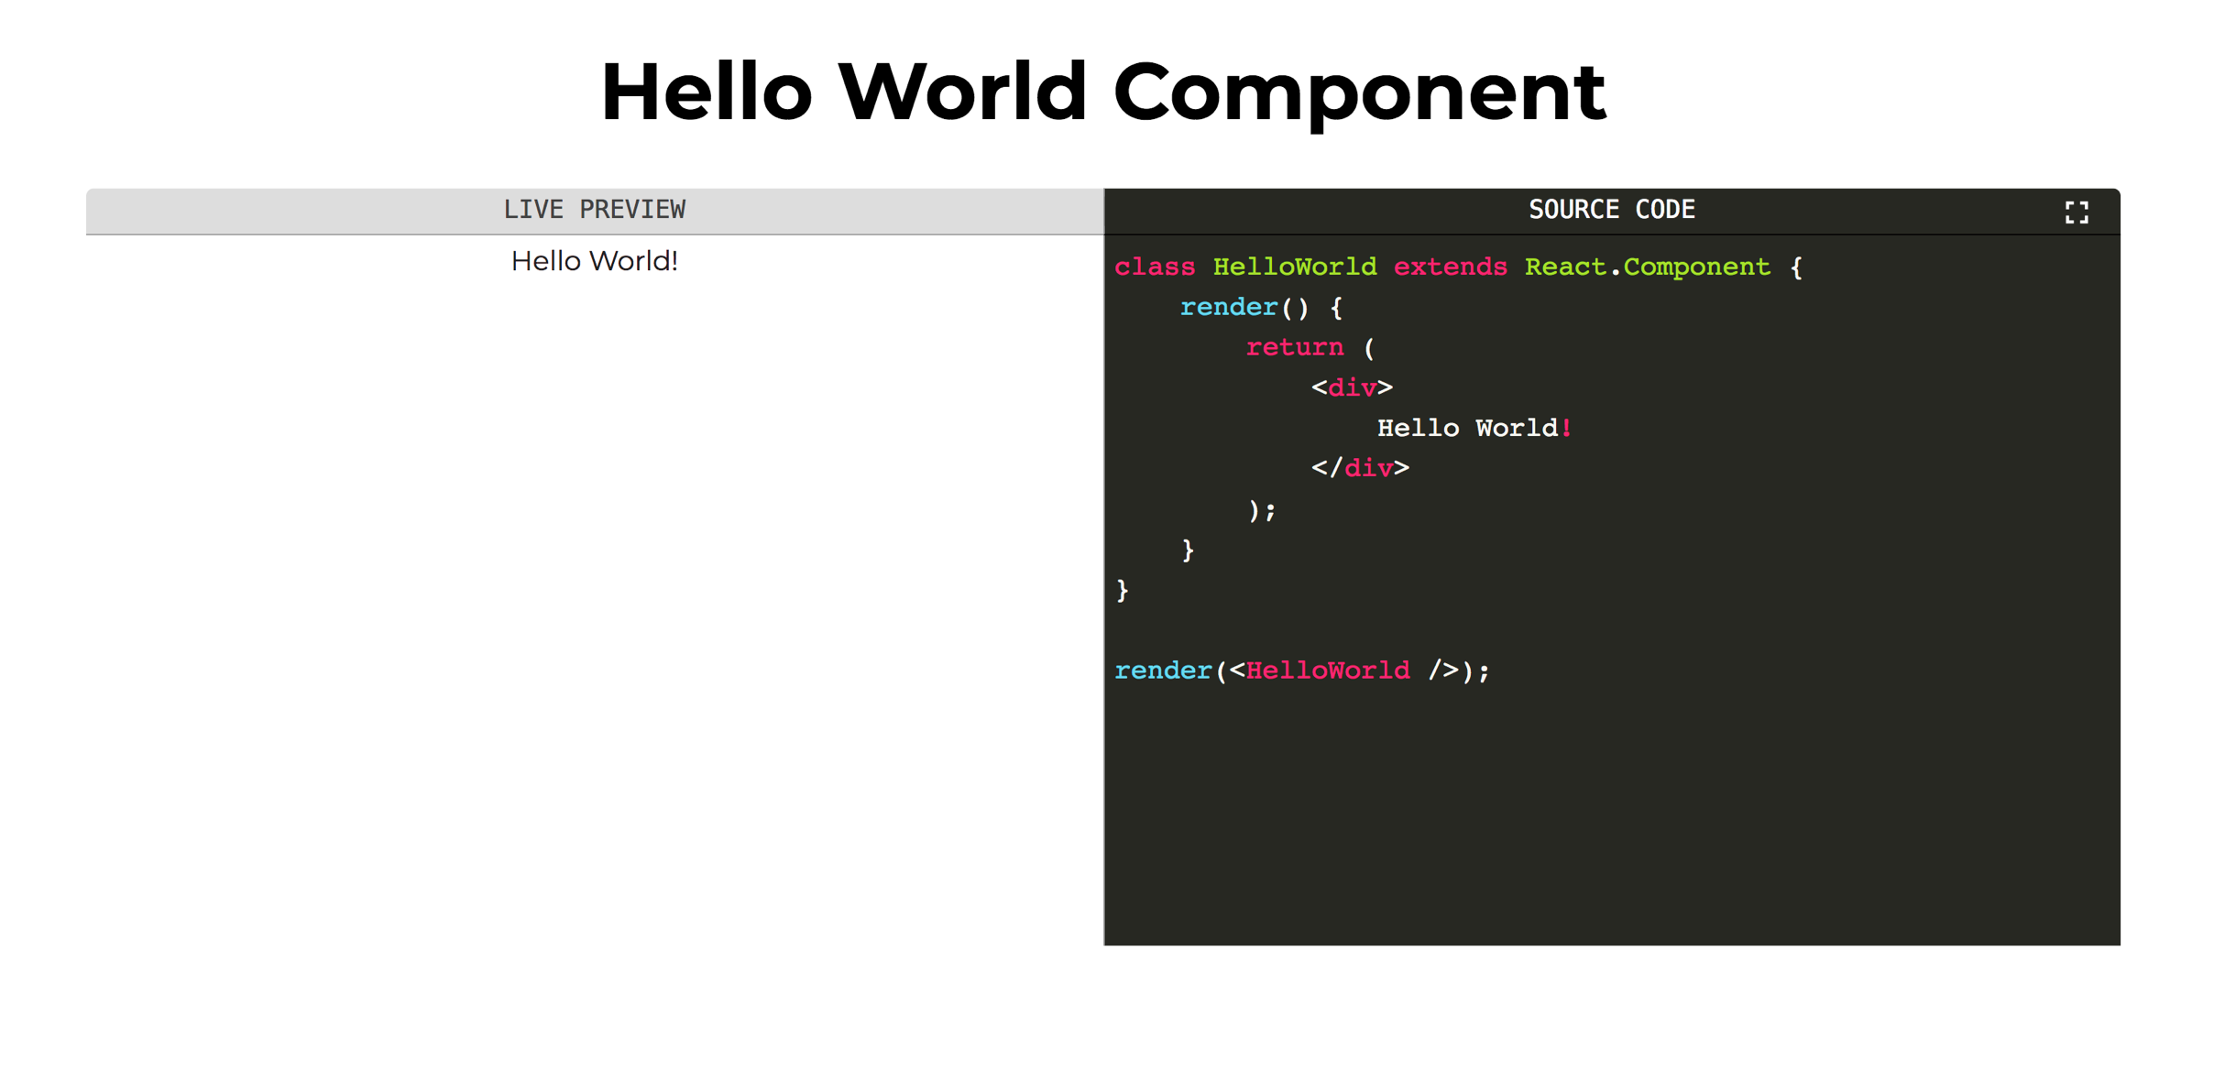

Slide 52
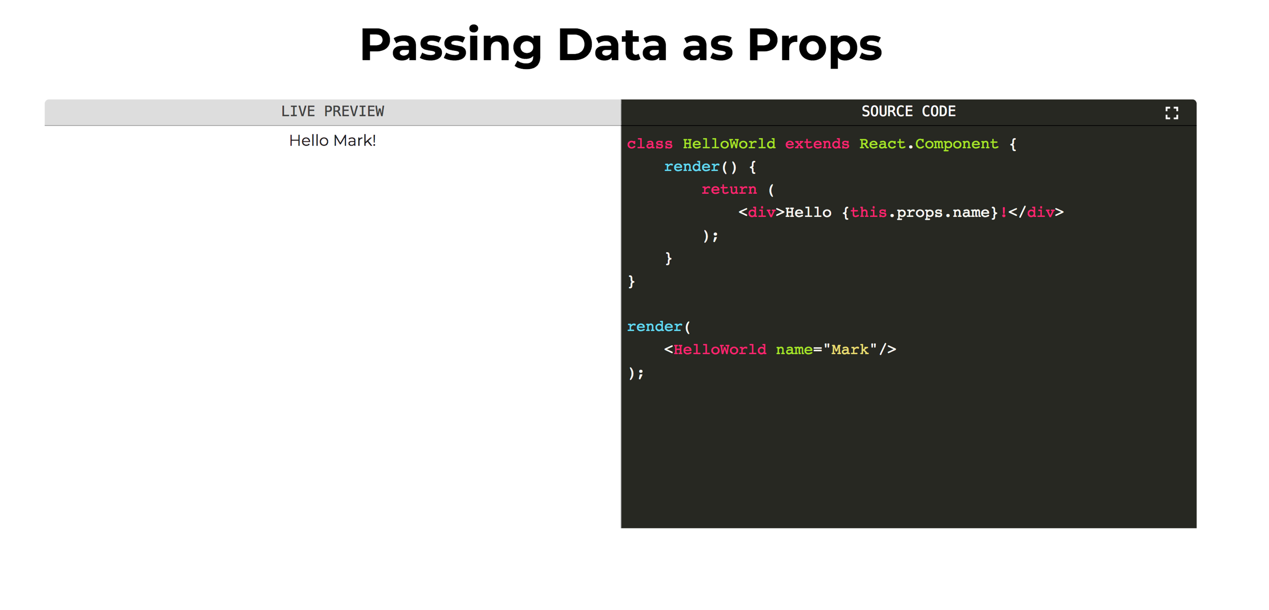

Slide 53
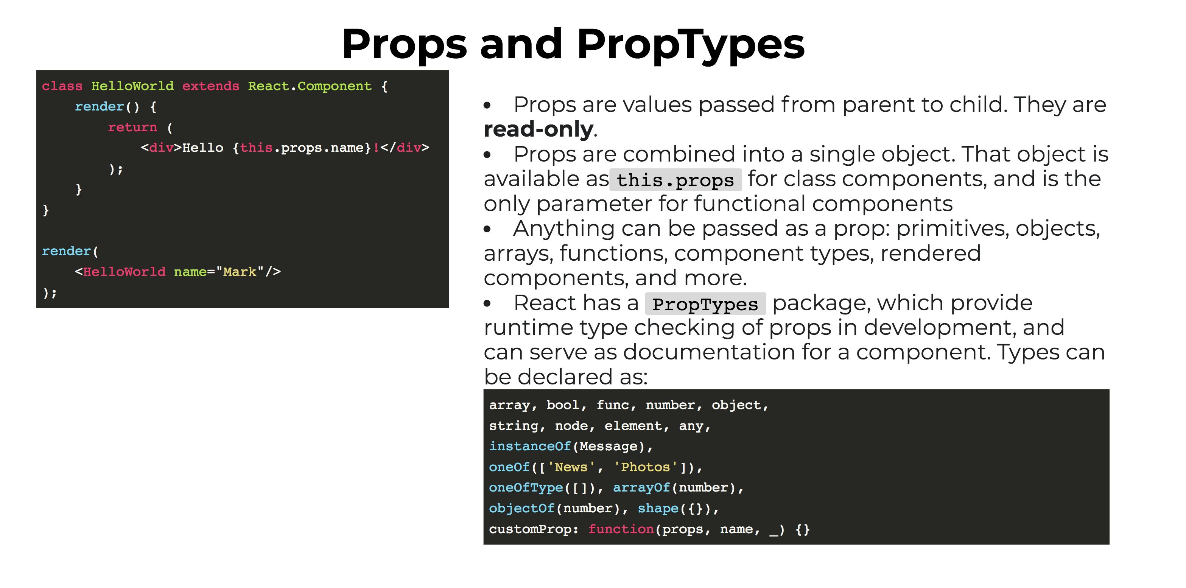

Slide 54
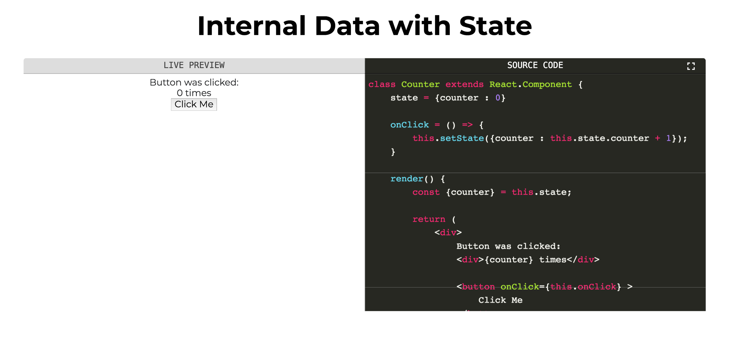

Slide 55
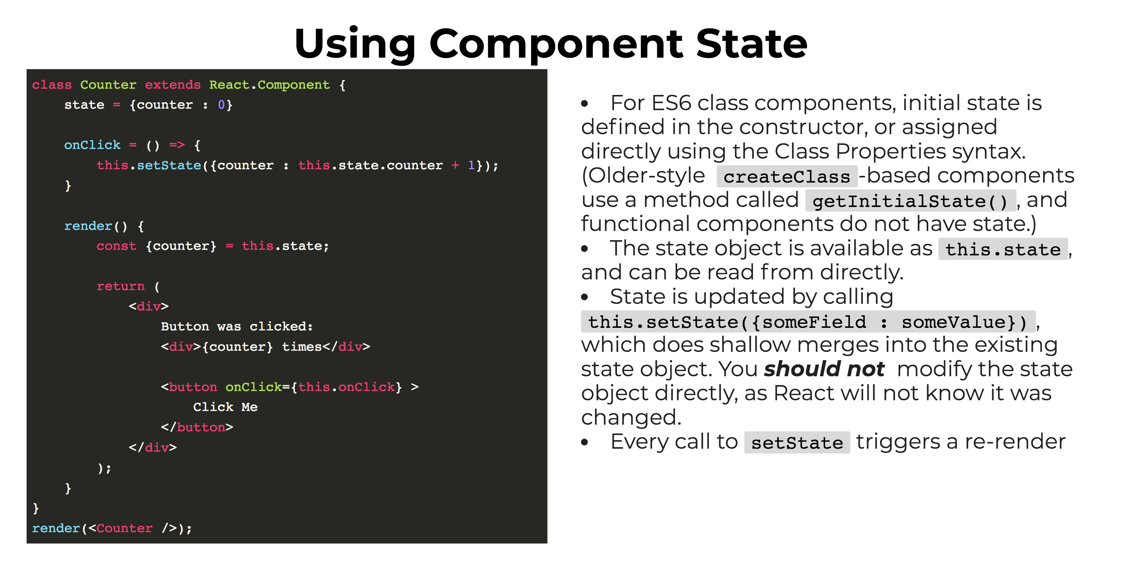

Slide 56
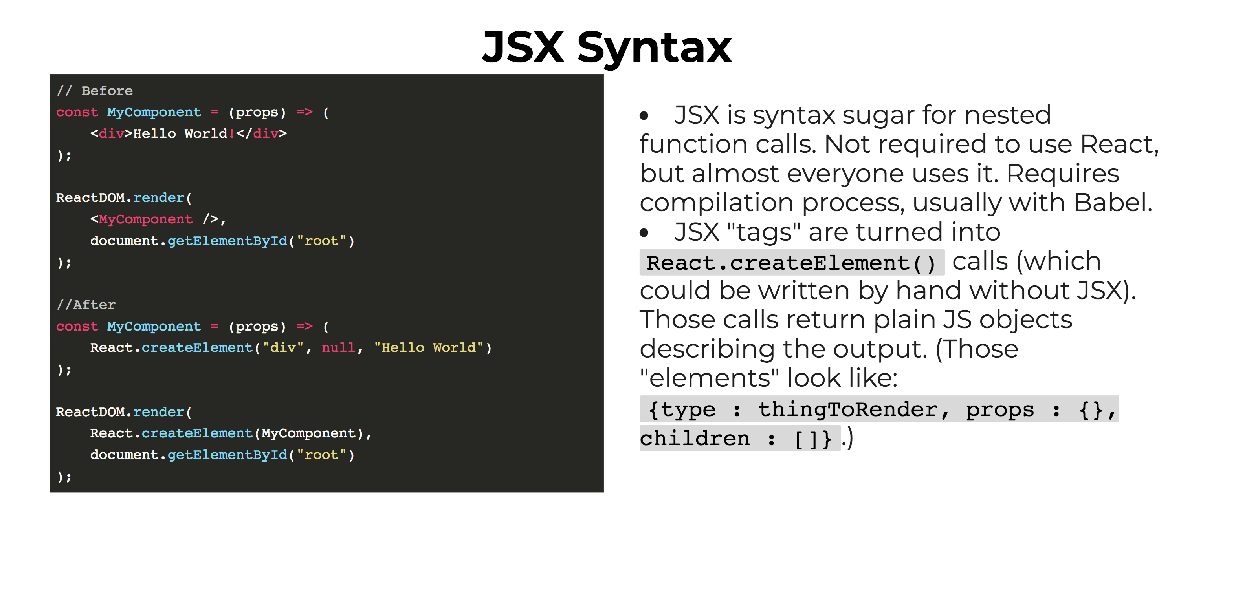

Slide 57
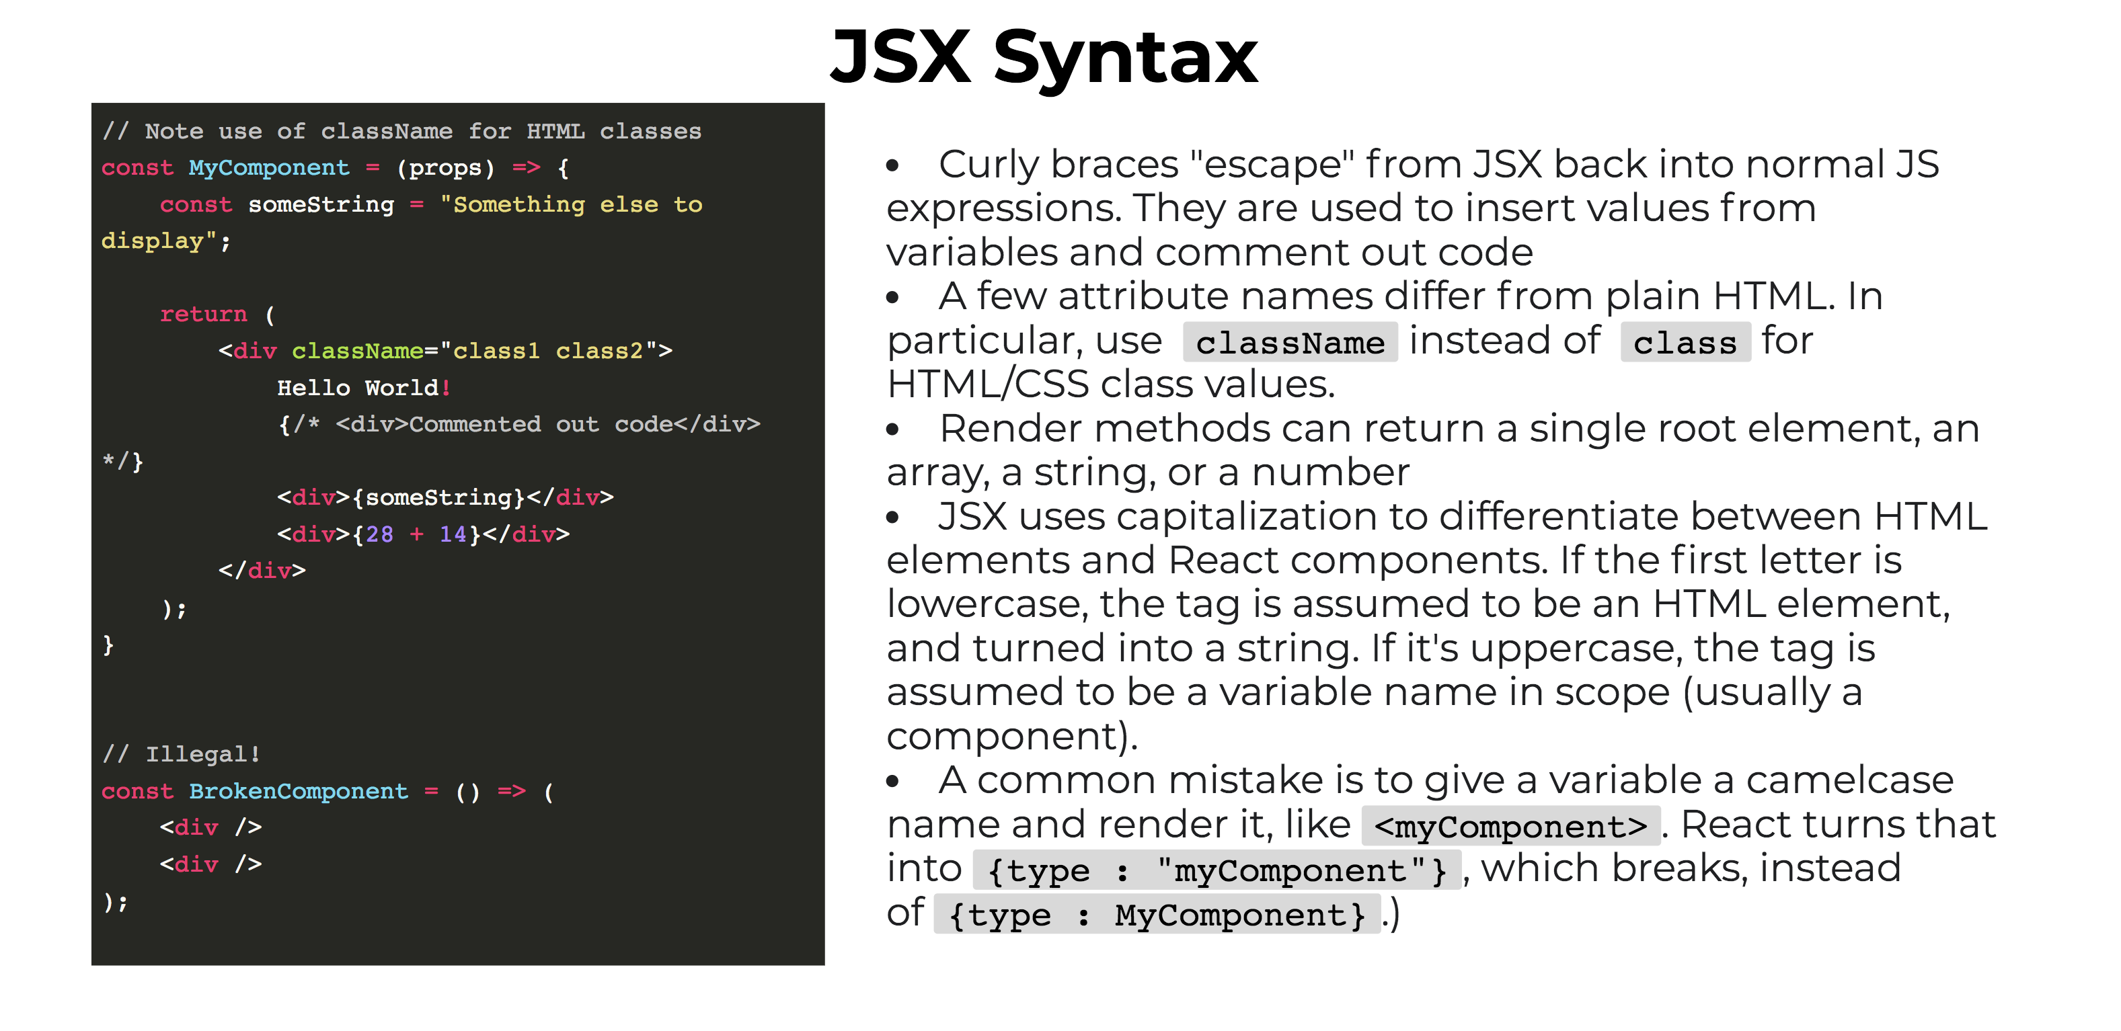

Slide 58
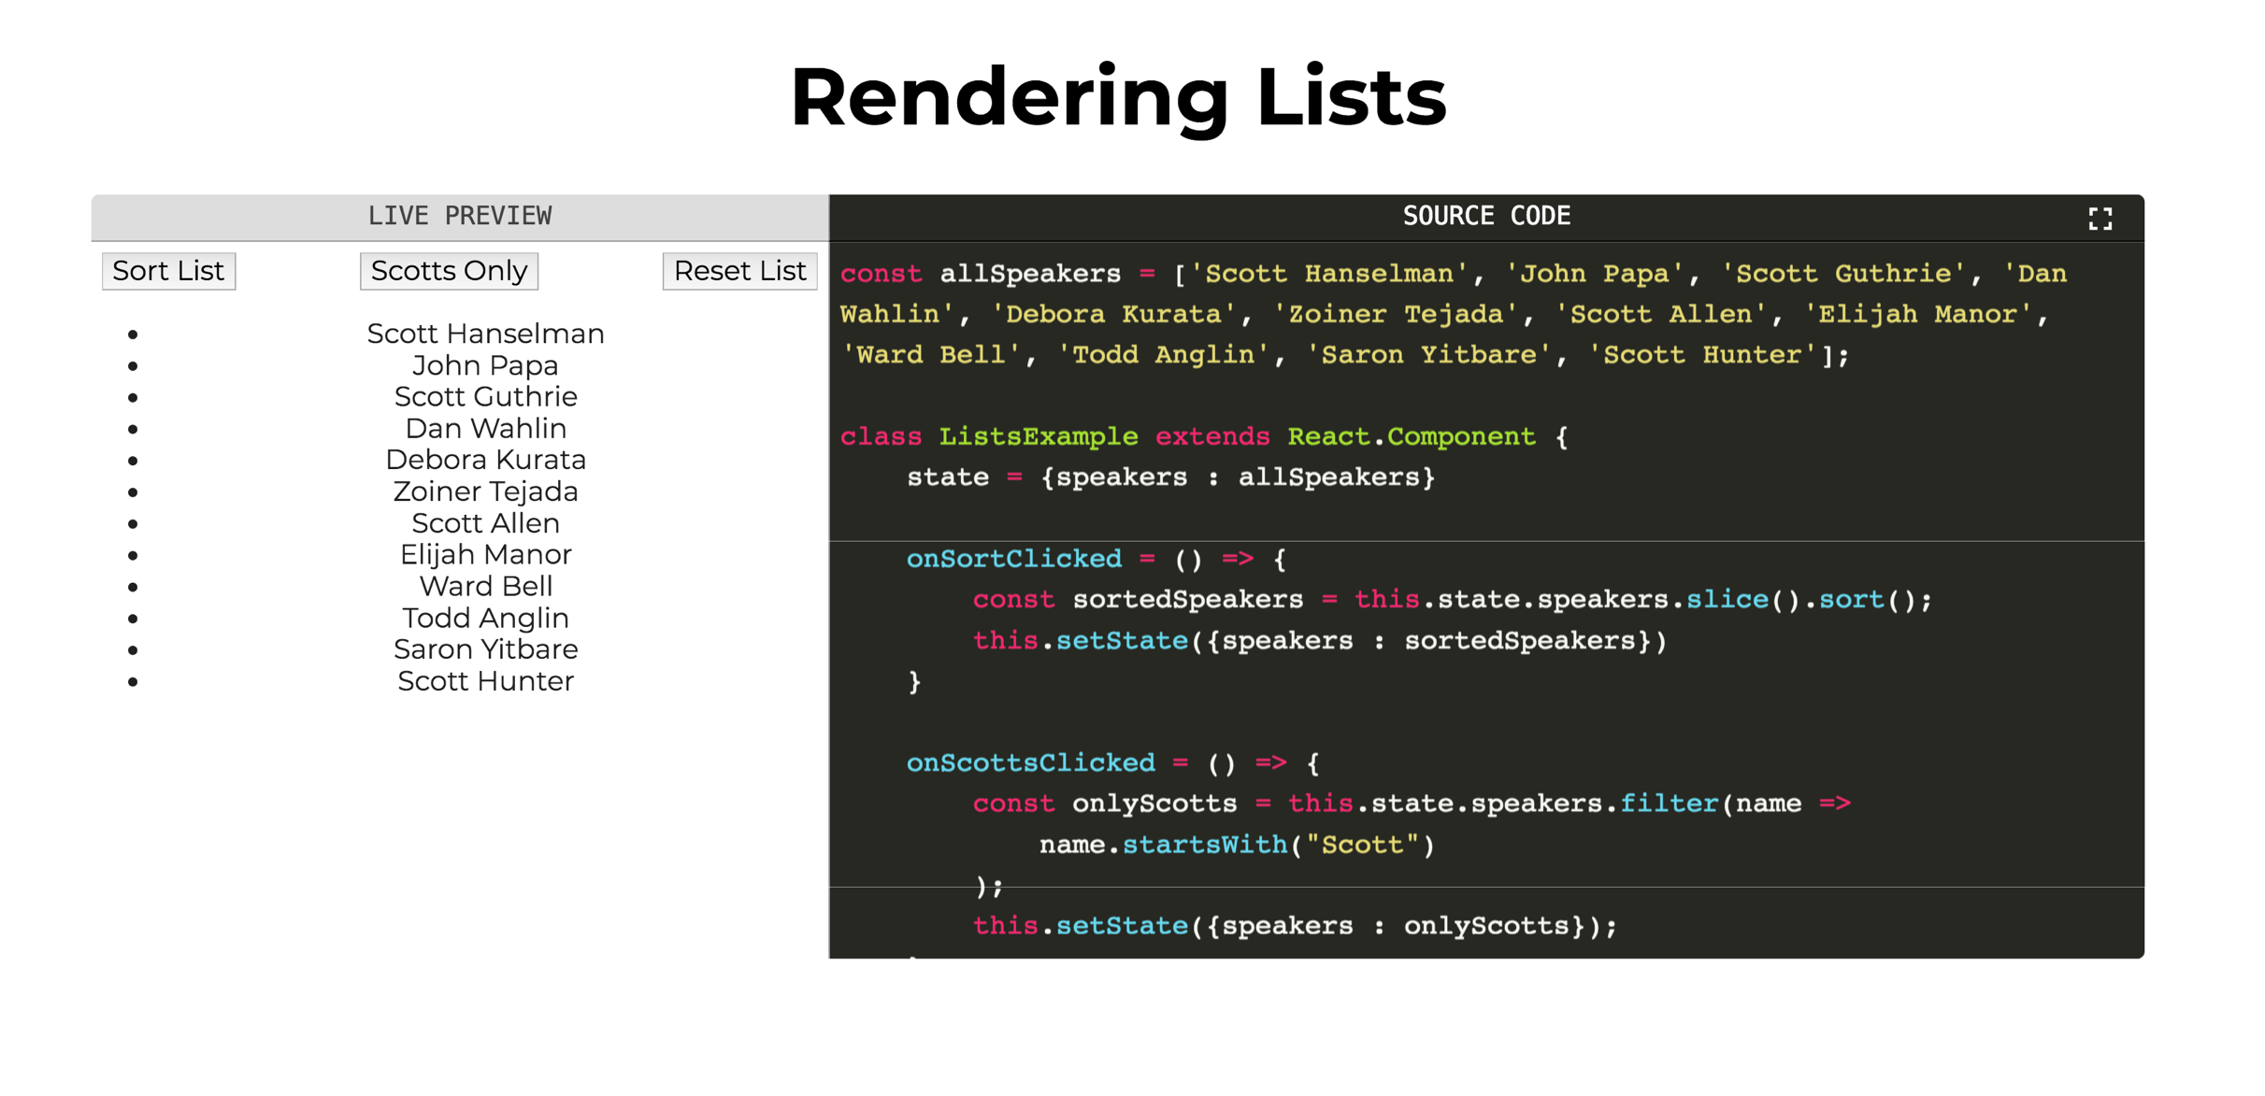

Slide 59
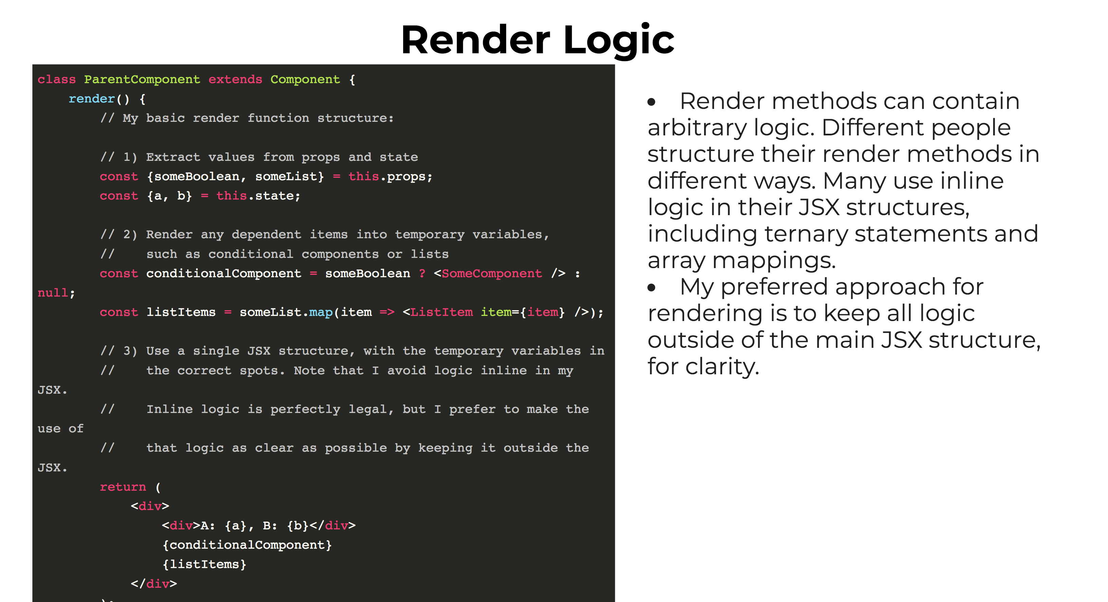

Slide 60
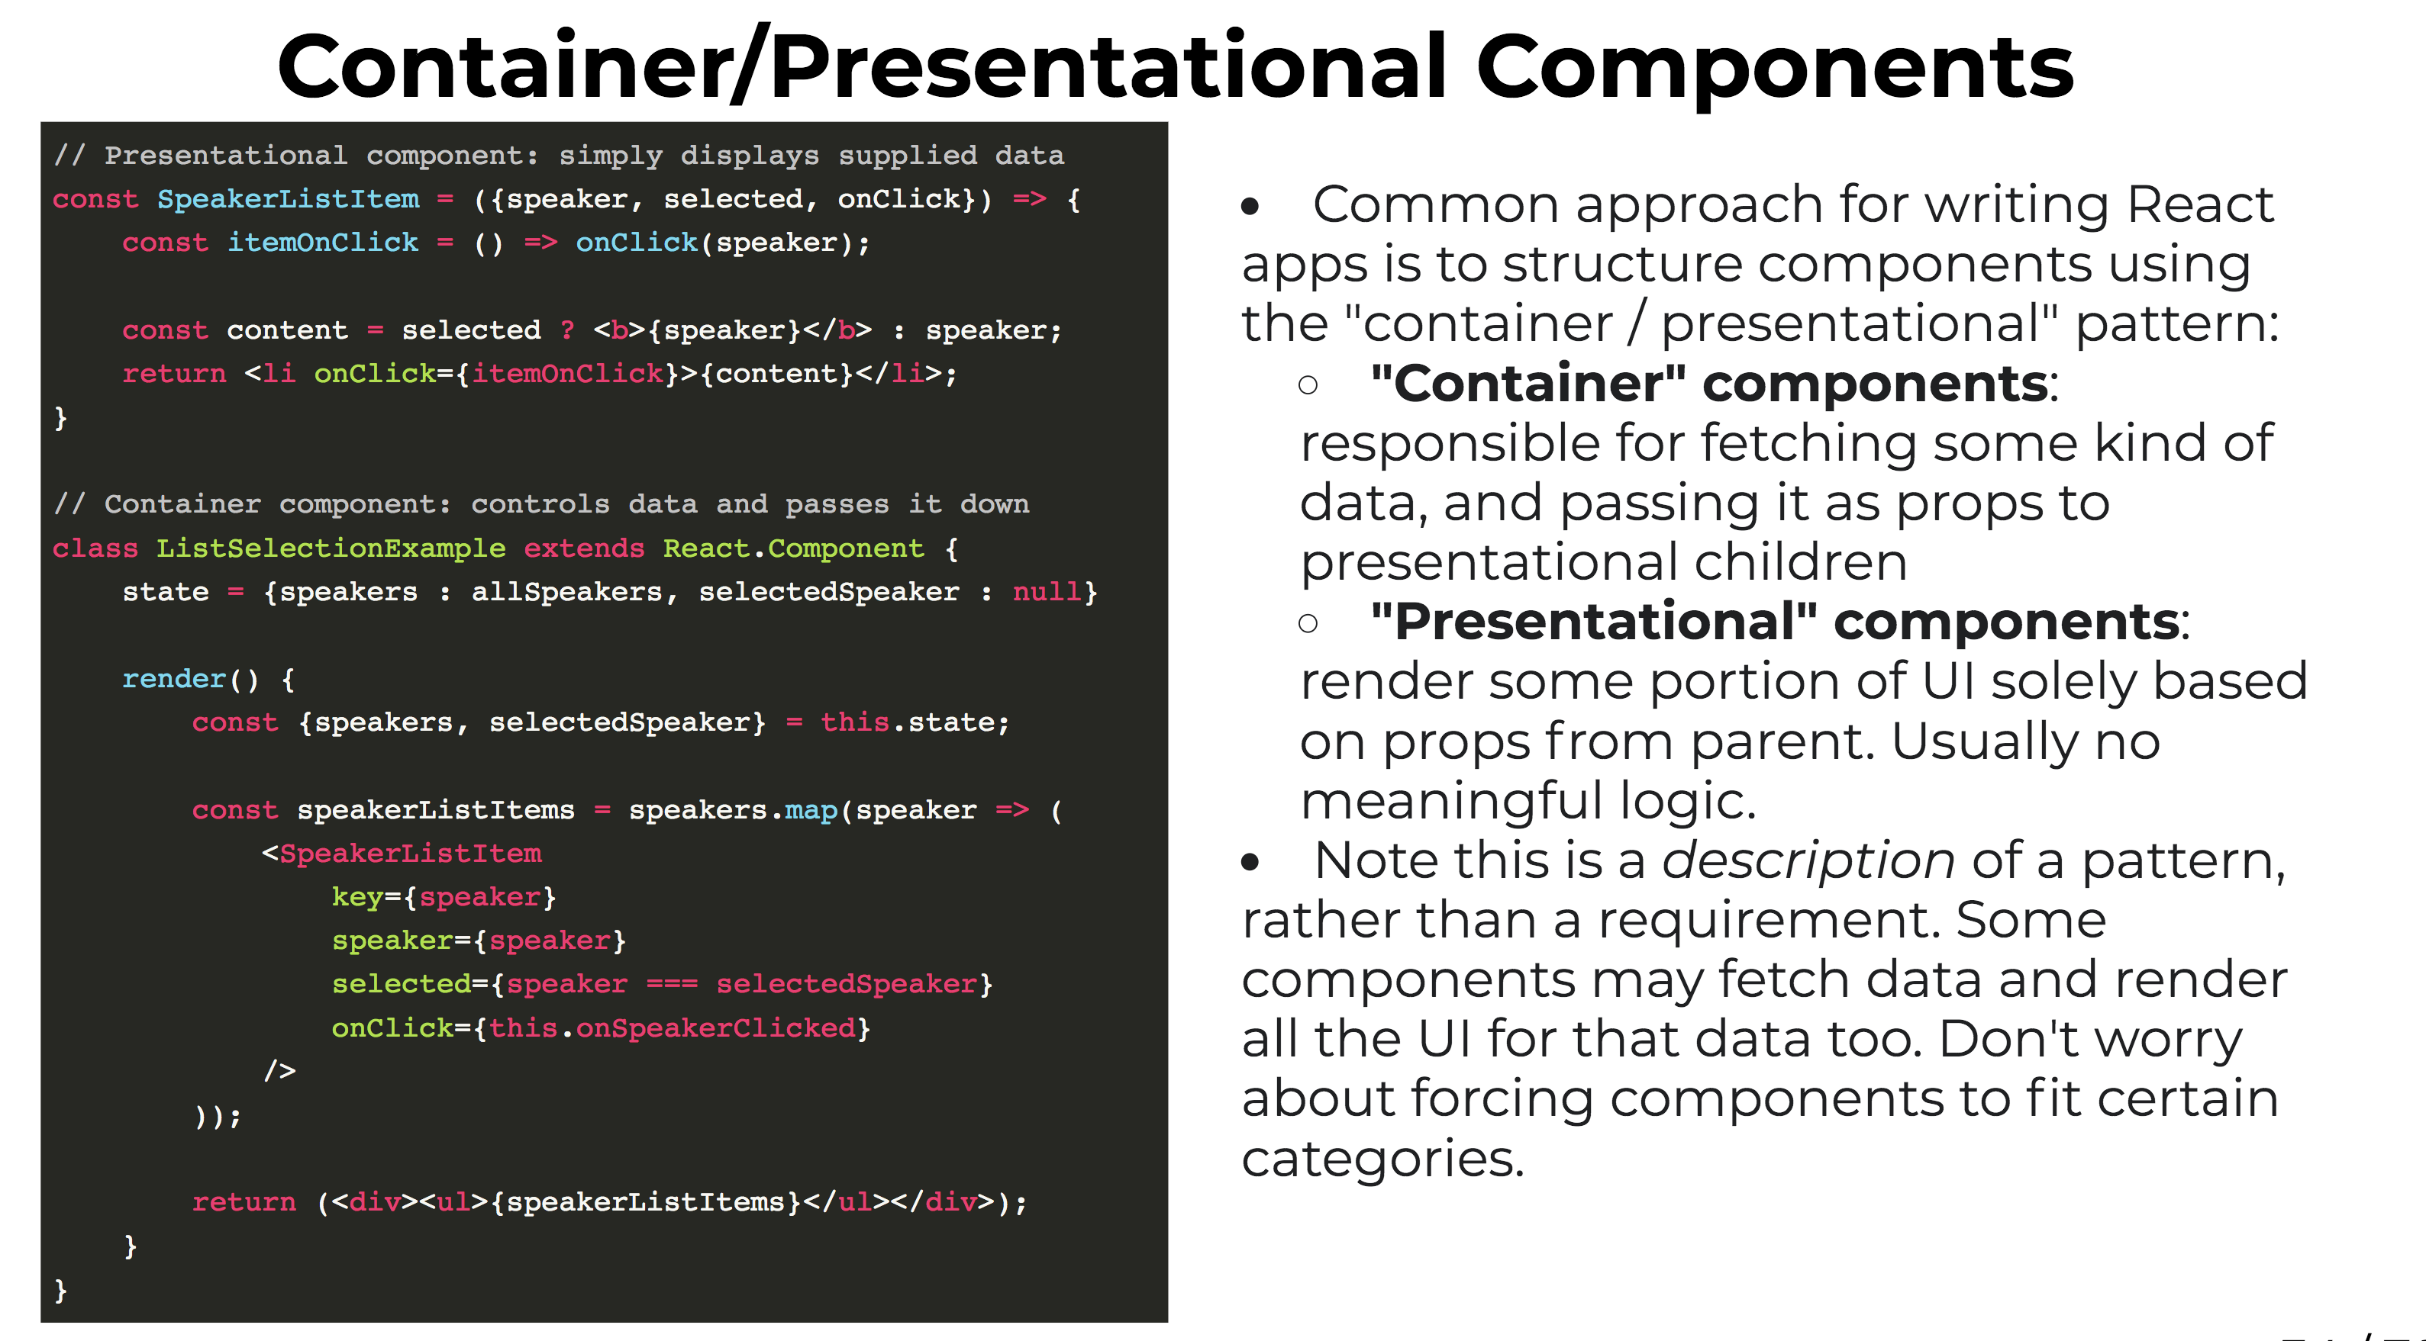

Slide 61
JSX
JSX is a JavaScript syntax extension that looks similar to XML.
// Input (JSX):
var app = <Nav color="blue" />;
// Output (JS):
var app = React.createElement(Nav, {color:"blue"});

Slide 62
Rendering a Component
import React from 'react'; import ReactDOM from 'react-dom';
const App = () => {
return (<p>Hello World!</p>);
}
const exampleNode = document.getElementById('example'); ReactDOM.render(<App />, exampleNode);
main.js -> bundle.js

Slide 63


Slide 64
Rendering a Component
<body>
<div id="example">
<p> <!-- App start --> Hello World!
</p> <!-- App end -->
</div>
</body>
index.html

Slide 65
Nested Components Part I
import React from 'react';
const Profile = ({avatar, name}) => { return (
<div>
<img src={avatar} />
<span>{name}</span>
</div>
);
}
profile.js

Slide 66
Nested Components Part II
import React from 'react'; import ReactDOM from 'react-dom'; import Profile from ‘./profile';
const App = () => { return (
<div>
<h1>Hello World!</h1>
<Profile avatar="http://test.png" name="Nik" />
</div>
);
}
const exampleNode = document.getElementById('example'); ReactDOM.render(<App />, exampleNode);
main.js -> bundle.js

Slide 68


Slide 69
Nested Components Part III
<body>
<div id="example">
<div> <!-- App start -->
<h1>Hello World!</h1>
<div> <!-- Profile start -->
<img src="http://test.png" />
<span>Nik</span>
</div> <!-- Profile end -->
</div> <!-- App end -->
</div>
</body>
index.html

Slide 70
Stateless Function Components
Functional Programming:
avoid changing-state
avoid mutable data
calling a function twice with the same values as arguments will produce the same result
Stateless Function Components:
avoid changing-state
avoid mutable data
calling a function twice with the same values as arguments will produce the same result

Slide 71


Slide 72


Slide 73


Slide 74
Predictable
Wait, but why?
easy to understand &
easy to test

Slide 75


Slide 76
If/Else
const Profile = ({name, isOnline}) => {
let onlineIndicator; if (isOnline) {
onlineIndicator = (<span>green</span>);
} else {
onlineIndicator = (<span>red</span>);
}
return (
<div>
{name} {onlineIndicator}
</div>
);
}
profile.js

Slide 77
If/Else
<Profile name="Nik" isOnline={false}/>
<div>
Nik <span>red</span>
</div>

Slide 78
Loop
const FriendList = ({friends}) => { return (
<ul>
{friends.map((friend) => { return <li>{friend.name}</li>;
})}
</ul>
);
}
friendlist.js

Slide 79
Loop
const friends = [
{ name: 'Max'},
{ name: 'Tom'},
];
<FriendList friends={friends} />
<ul>
<li>Max</li>
<li>Tom</li>
</ul>

Slide 80
React Summary
We can create out own components
We can nest components as we like
Stateless Function Components are pure
We can control flow via JS (if, else, for, map …)

Slide 81
Interaction
const Profile = ({name}) => { return (
<div>
{name}
<button onClick={ console.log('Clicked!'); }> Click me!
</button>
</div>
);
}
profile.js

Slide 82
What to do with interactions like
onMouseOver, onSubmit & onClick?

Slide 83


Slide 84
Redux to rescue!
Redux allows you to manage the state with a minimal API but completely predictable behaviour.

Slide 85

What about Flux?
Source: https://twitter.com/codecartoons/status/667348216669741056

Slide 86
Basic Principle
(previousState, action) => newState

Slide 87


Slide 88
Redux Flow
dispatch(action)
(previousState, action)
Store Reducers
Action Creators
(newState)
(state)
React Components
Interaction e.g onClick

Slide 89

Feels like Fear just turned into a Superpower

Slide 90
Action
const action = { type: 'ADD_TODO', text: 'Call Mom',
}

Slide 91
Action Creator
function addTodo(text) {
const trimmedText = text.trim(); return {
type: 'ADD_TODO', text: trimmedText,
}
}
actions.js
<button onClick={ dispatch(addTodo('Call Mom Add Todo
</button>
') }>

Slide 92
Reducer
const todos = (state = [], action) => { switch (action.type) {
case 'ADD_TODO': return [
...state,
{
text: action.text, completed: false
}
]
default: return state
}
}
reducers.js

Slide 93
Store
import { createStore } from 'redux' import todoReducer from '../reducers' let store = createStore(todoReducer);
store.subscribe(() => console.log(store.getState())
)
store.dispatch(addTodo('Learn about reducers'));
store.dispatch(addTodo(‘Call Mom'));

Slide 94
Connect React with Redux
import React from 'react'; import ReactDOM from 'react-dom';
import { createStore } from 'redux'; import { Provider } from 'react-redux'; import todoApp from './reducers'; import App from './containers/App';
let store = createStore(todoApp);
let exampleNode = document.getElementById('example'); ReactDOM.render(
<Provider store={store}><App /></Provider>, exampleNode
);

Slide 95
Connect React +Redux
import React from 'react';
import { connect } from 'react-redux';
import { addTodo } from '../actions.js';
const App = ({dispatch, state}) => { return (
<button onClick={ dispatch(addTodo('Call Mom') }> Add Todo
</button>
);
};
export default connect(App);

Slide 96
Redux Summary
Redux allows you to manage the state with
predictable behaviour.
(previousState, action) => newState

Slide 97


Slide 98
Time-travel Demo

Slide 99
Why this Stack?
Reusable Components
Predictable Code (functional)
TimeTravel
Performant & lightweight

Slide 100
The End
Thanks for listening!
https://github.com/yagneshmodh https://twitter.com/imyagnesh
React + Redux
@imyagnesh

